Slide 1

Design Topic of Robotics engineering ——Farewell Robot
team members：曾庆怡 温佩松 范嘉骏 韦知辛 李天奕

Slide 2

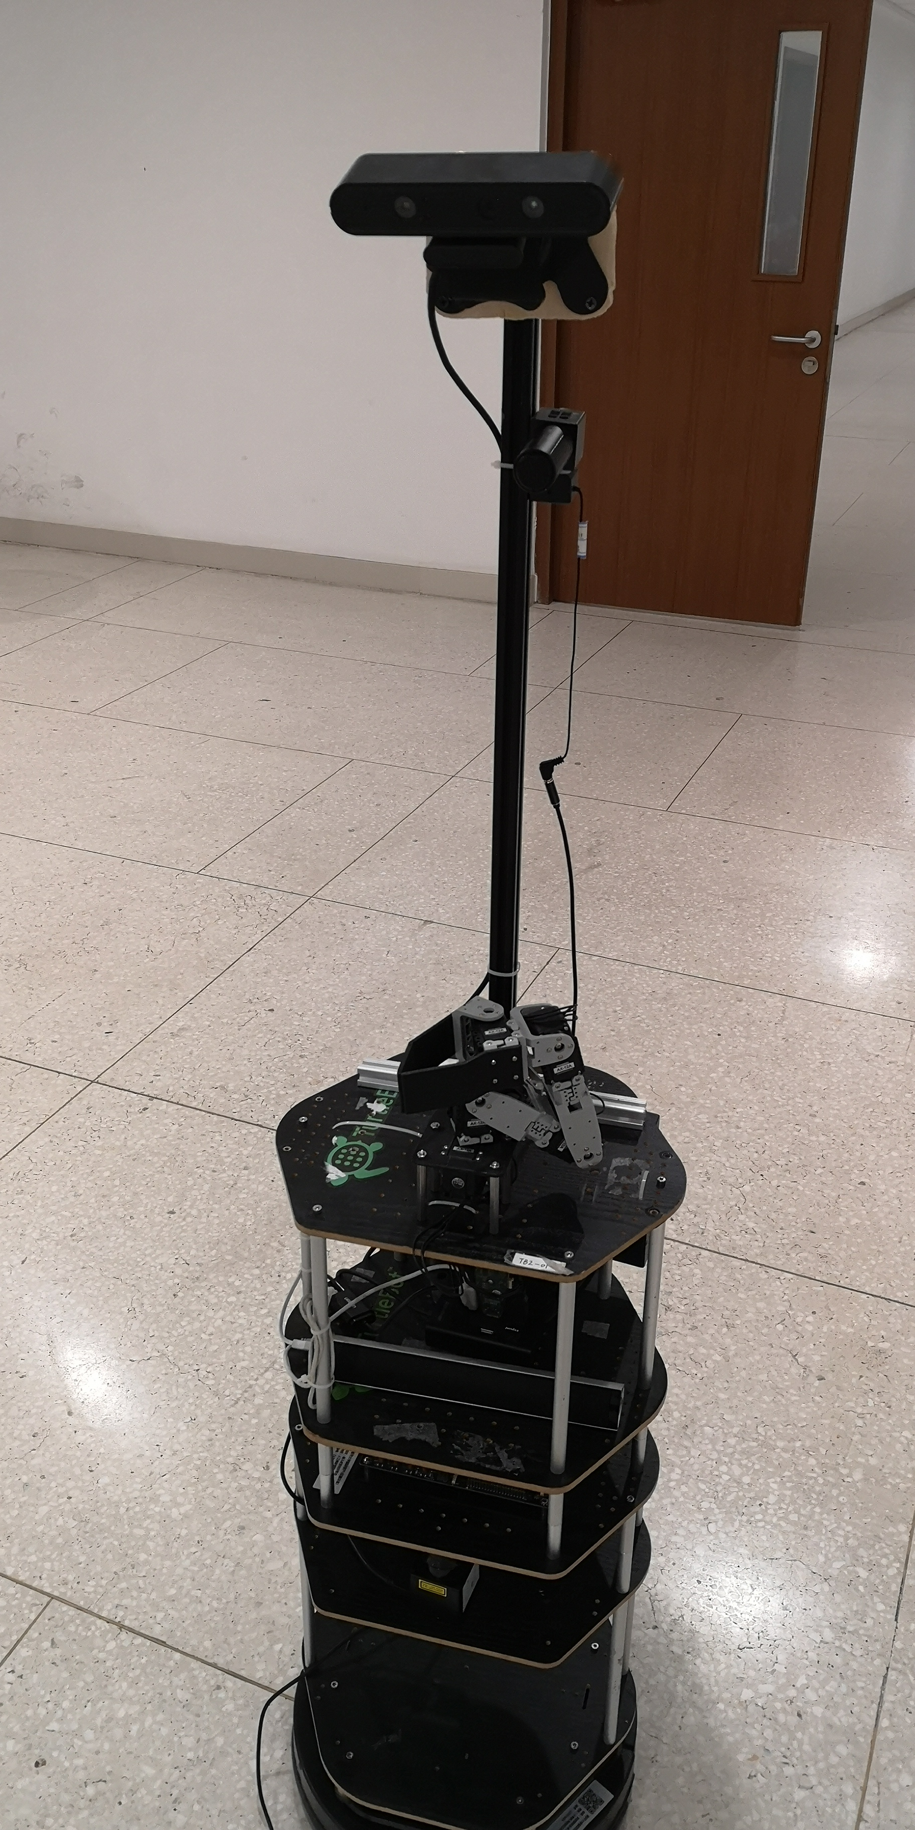
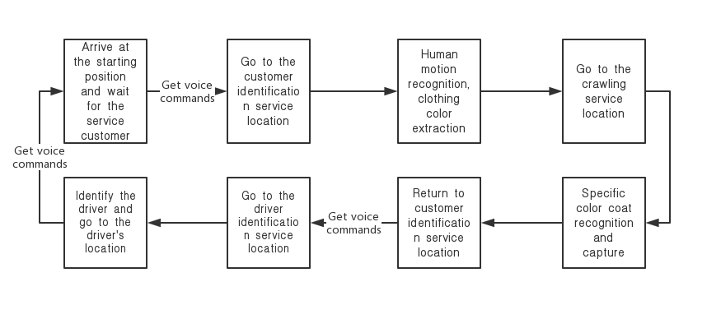
Topic Goal
Background：People who had just finished their meal began to take taxis and go home. The robot helps them carry their luggage and leads them to a designated taxi spot.

Slide 3
Technology involved
Map navigation
No map navigation
Human wave gesture recognition
Background subtraction and subject color extraction
Color target recognition
Robotic arm grab motion planning
Voice command recognition
Basic voice conversation

Slide 4
speech interaction
Arrive at the starting position
Xunfei recognize:
I want to leave/go
Pub “leave”
Stat recognizing
the person
Return to the customer
Xunfei recognize:
Let’s go out
Pub “go out”
Go to the driver
Arrive at the
driver’s position
Xunfei recognize:
You can go back
Pub “go back”
Return the start position

Slide 5
speech interaction
Key words spotting to determine the intention of the customer.
If it is not recognized, continue to wake up the recognize node, and continue to recognize
韦知辛

Slide 6
THANK YOU FOR WATCHING

